Slide 1
MY Voyage in Canon Ocean…
GURUCHETHAN D P

Slide 2
Learning
Perl
Perl language
Perl Exercises
Unix
Unix shell commands
Unix shell scripting
Make files
VHDL & Verilog
Designed basic modules like Counter, Mux etc

Slide 3
Learning (contd)
System Verilog
SV constructs like interface, clocking blocks, program blocks, randomization, assertions and coverage.
Counter TestBench example
Visual Basic
Excel VBA constructs
Exercises on developing Excel macro
Video Codec
Image coding technique
Video coding
Features of MPEG and H.264/ AVC standard

Slide 4
Counter module
RESET
COUNTER
COUNT[SIZE-1:0]
ENABLE
SIZE
CLK

Slide 5
VERIFICATION ENVIRONMENT
FUNCTIONAL COVERAGE
TOP
ASSERTIONS
COVEARGE
GROUPS
COUNTER
DUT
TESTCASES
INTERFACE
CLOCK GENERATOR
RANDOMIZATION

Slide 6
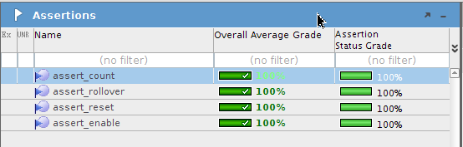
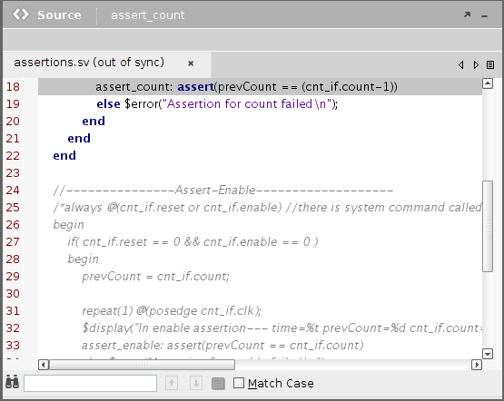
Assertion coverage result

Slide 7
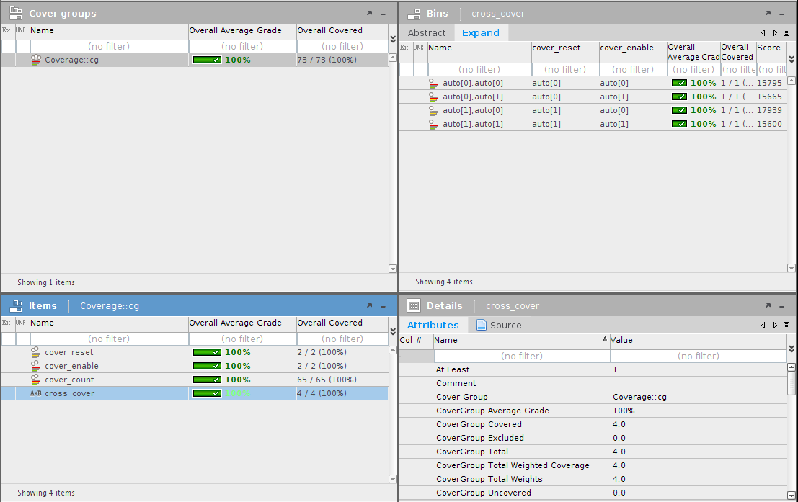
Coverage group analysis

Slide 8
VIDEO CODEC

Slide 9
JPEG Image coding [Ref: Image compression and the Discrete Cosine Transform, Ken Cabeen and Peter Gent]
The image is broken into 8x8 blocks of pixels
DCT is applied to this 8x8 block
Each block is compressed through quantization
Blocks are coded in a zigzag path and array of blocks are stored in drastically reduced space
When desired, image is reconstructed by applying inverse quantization and IDCT

Slide 10
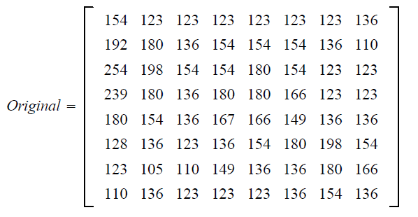
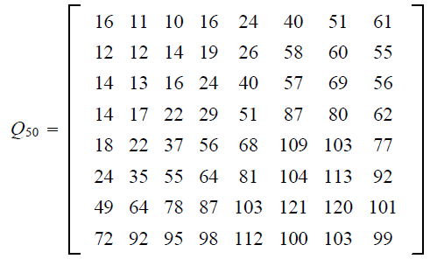
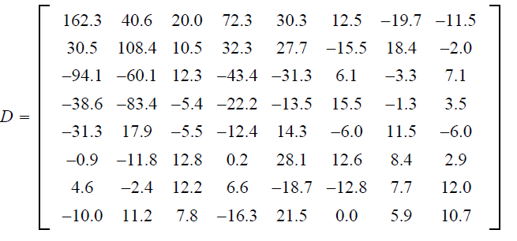
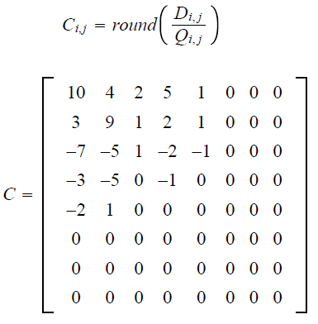
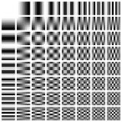
Example demonstrating the JPEG process [Ref: Image compression and the Discrete Cosine Transform, Ken Cabeen and Peter Gent]

Slide 11
MPEG - Video compression
Intra mode
Entire block is coded using image compression methods like JPEG
Used for blocks which cannot be predicted well
Inter mode
Large amount of temporal redundancy in the video content.
For each 16x16 ( macro block), find the best match from previous frame
Prediction error will be coded using DCT
One pair of motion vectors are also coded.
Bidirectional mode
Same as Inter mode but macro block is predicted from previous and following frame
Hence 2 pairs of the motion vector are required

Slide 12
Inter + 4V mode
Same as Inter mode except 4 motion vectors are used
Skip mode
Some areas of the frame can just be repeated without any change

Slide 13
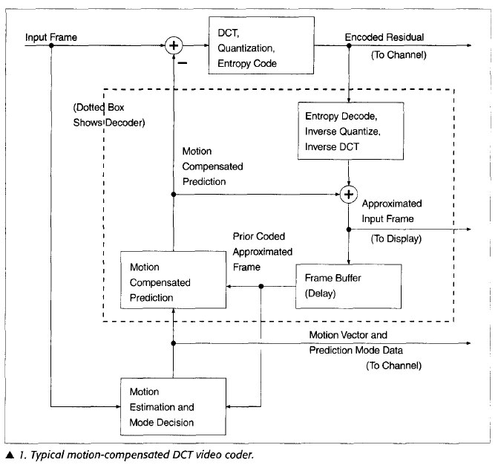
DCT video coder [Ref: Rate-distortion optimization for video compression, Gary J Sullivan and Thomas Wiegand]

Slide 14
H.264/ AVC features
2 conceptual layer structure
Video Coding Layer ( VCL): defines efficient representation of the signal
Network Adaption Layer ( NAL ): Converts VCL representation into a format suitable for a specific transport layer
Intra frame prediction-
Prediction within a single frame

Slide 15
H.264/ AVC features ( contd..)
Memory
For motion compensation, multiple video frames are used instead of one.
Deblocking filter
Used to improve visual quality and prediction performance by smoothing the sharp edges which can form between macroblocks when block coding techniques are used.
Integer transform
Simple approximation to DCT

Slide 16
Lagrangian Formulation
Min{ J }, where J = D +λR
Where J- Lagrangian rate- distortion function
D- Distortion measure like PSNR
λ- Lagrange multiplier
R- Bit Rate
We need to minimize J for a given value of λ and Rc.
λ specifies the relative emphasis between the R and distortion

Slide 17
CHOOSING THE BEST VIDEO BASED ON PSNR AND BITRATE

Slide 18
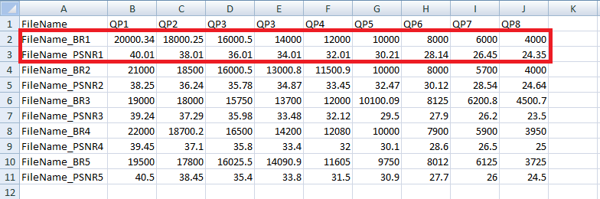
Inputs and Outputs for Choosing Best Video
Input -> A set values as shown below
Let me call each Filename_BRx and Filename_PSNRx as a “Video”(Highlighted below)
Output -> Macro that gives the Best Video considering all QP(Quantization Parameter) range

Slide 19
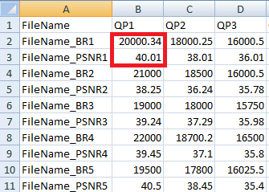
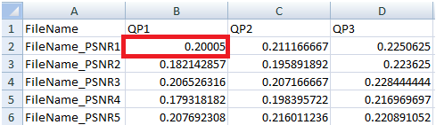
Choosing Best Video – v1
For each QP value, calculate the ratio (PSNR/BR) x 100 as shown

Slide 20
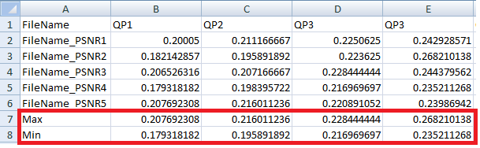
Choosing Best Video – v1 (contd)
For each QP, compute the max and min (PSNR/BR) ratio as shown

Slide 21
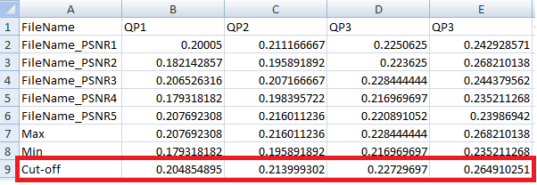
Choosing Best Video – v1 (contd)
For each QP, compute a cut-off value for (PSNR/BR) ratio based on threshold inputted by the user.
Cut-off = max – ( (max – min) x threshold/100 )

Slide 22
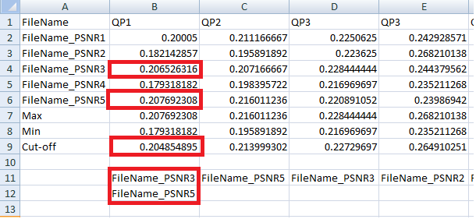
Choosing Best Video – v1 (contd)
List the Videos whose (PSNR/BR) ratio is above cut-off

Slide 23
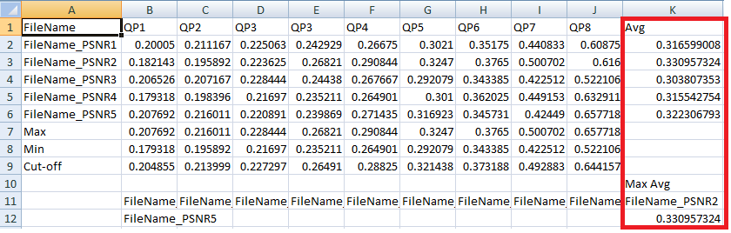
Choosing Best Video – v1 (contd)
Also for each Video, compute the Avg of (PSNR/BR) over all QPs and compute the Video with Max Avg.

Slide 24
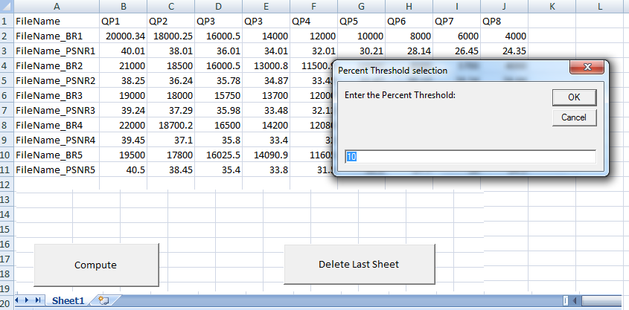
Choosing Best Video – v1 (contd)
Macro
When the button is clicked, it asks the user for threshold value

Slide 25
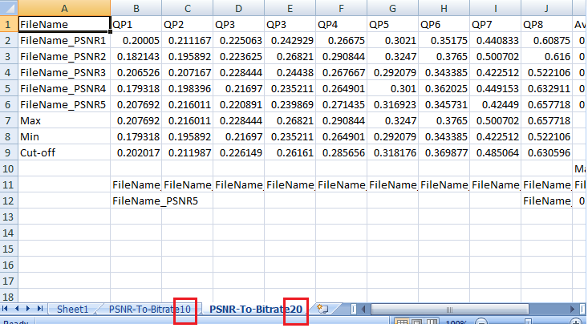
Choosing Best Video – v1 (contd)
Result
Result will be updated in a separate sheet with the name containing the threshold as suffix

Slide 26
Choosing Best Video – v2
Modifications from v1
“Count on the filenames that are above cut-off over all QPs” is included
The sorted (descending order – highest value first) list of filenames above cutoff value is printed along with their

Slide 27
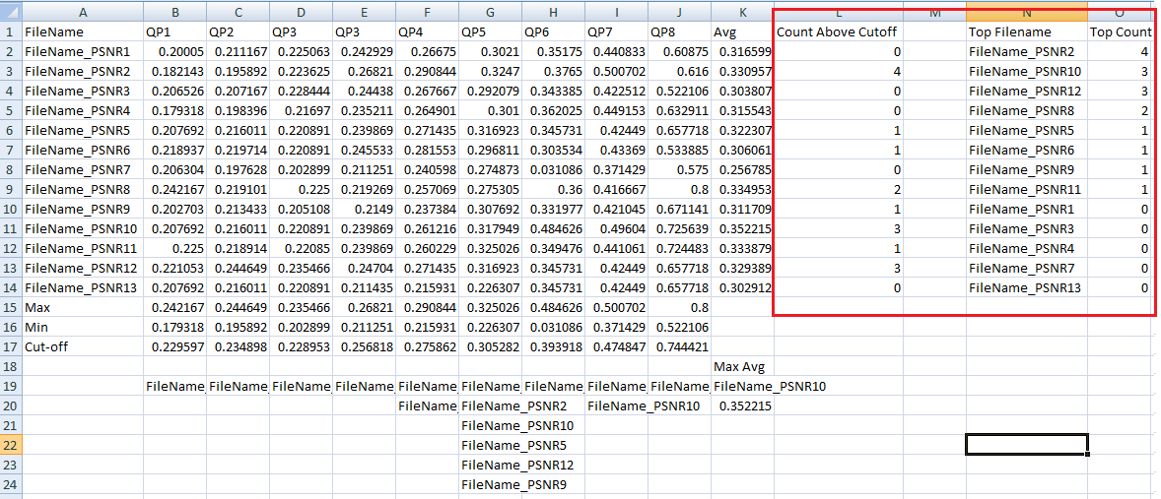
Choosing Best Video – v2 (contd)

Slide 28
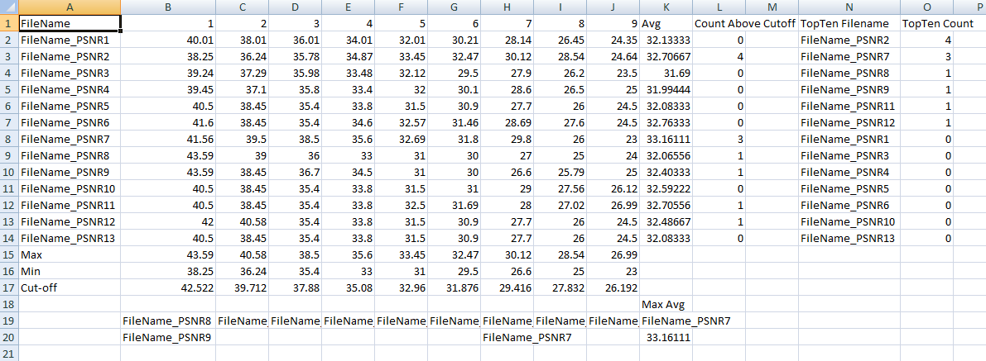
Choosing Best Video – v3
Modifications
Instead of (PSNR/BR) ratio, only PSNR is considered as a metric to choose the best curve and Bitrates are ignored.

Slide 29
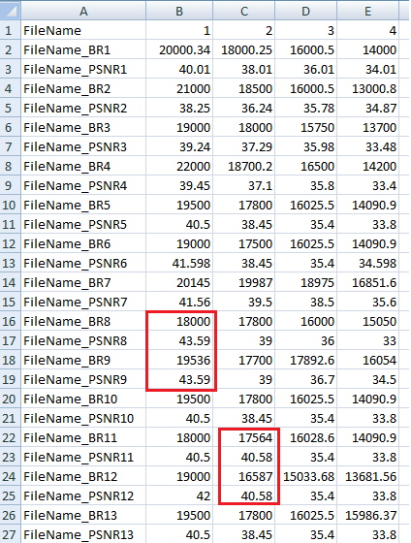
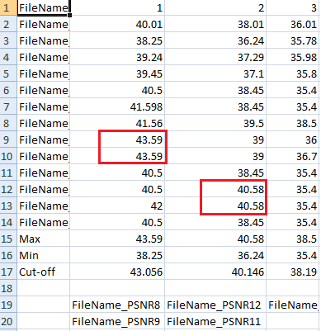
Choosing Best Video – v4
Modifications
When the PSNRs are equal then Bit rate is considered a metric to choose the best Video.

Slide 30
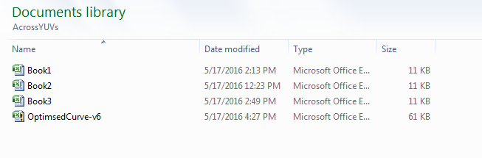
Choosing Best Video – v5
Modifications
Earlier macros were used to compute the best video in a single excel book.
This macro lists the best video for each QP value and for each excel book

Slide 31
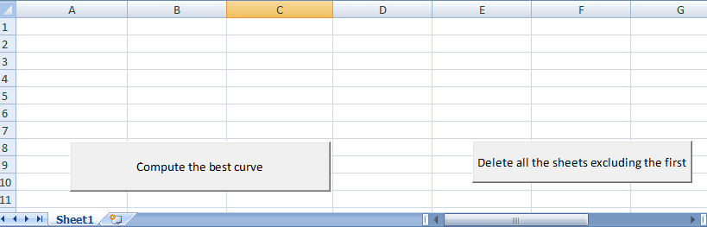
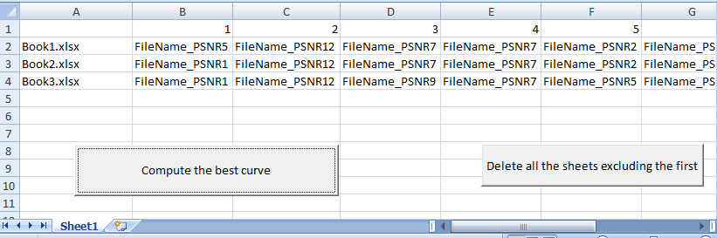
Choosing Best Video – v5 (contd)

Slide 32
References
Image compression and the Discrete Cosine Transform, Ken Cabeen and Peter Gent
Source Coding and compression by Heiko Schwarz
Video coding with H.264/AVC by Ostermann, Bormans, List, Marpe, Narroschke, Pereira, Stockhammer, Wedi
Rate-distortion optimization for video compression, Gary J Sullivan and Thomas Wiegand
Block matching Algorithms for motion estimation by Aroh Barjaty

Slide 33
THANK YOU
Q & A

